Slide 1
Advanced C
Input/Output Library
Th.S Nguyen Minh Anh
Phenikaa University
Last Update: 27th February 2023

Slide 2
Recap
We have learned how to handle console input and output:
The std::cout to print out console
The std::cin to input from keyboard
What if our data from file instead of keyboard? or we want to store output into a file instead of just printing it out?

Slide 3
Outline
Stream Concept
How to interact with files using fstream
Reading in a File Writing to a File
String Streams

Slide 4
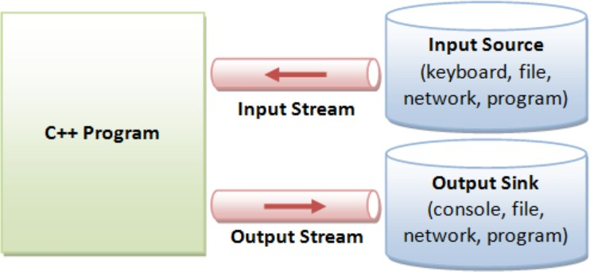
Definition
stream
Sequence of bytes flowing in and out of the programs
Think of streams as a pipeline of data (just like water and oil flowing through a pipe).
Streams acts as an interface between the programs and the actual IO devices
Streams convert between data and the string representation of data.

Slide 5
Two ways to classify streams
By Direction:
Input streams: Used for reading data (ex. std::istream, std::cin)
Output streams: Used for writing data (ex. std::ostream, std::cout)
Input/Output streams: Used for both reading and writing data (ex. std::iostream, std::stringstream)
By Source or Destination:
Console streams: Read/write to console (ex. std::cout, std::cin)
File streams: Read/write to files (ex. std::fstream, std::ifstream, std::ofstream)
String streams: Read/write to strings (ex. std::stringstream, std::istringstream, std::ostringstream)

Slide 6
Output Streams
An output stream lets you take data from your program and output it to a source (like the console, a file, etc.).
Can only send data to the stream.
Send data using stream insertion operator: <<
Converts data into string and sends to the stream. The std::cout stream is an example of an output stream.
std::cout << 5 << std::endl;
// converts int value 5 to string ’5’
// sends ’5’ to the console output stream

Slide 7
Input Streams
An input stream lets you get data from a source (like user input, a file, a webpage, etc.) and read it in your program.
Can only receive data.
Pull out data using stream extraction operator: >>
Extraction receives data from stream as a string and converts it into the appropriate type.
The std::cin stream is an example of an input stream.
int x;
string str;
std::cin >> x >> str;
//reads exactly one int then one string from console

Slide 8
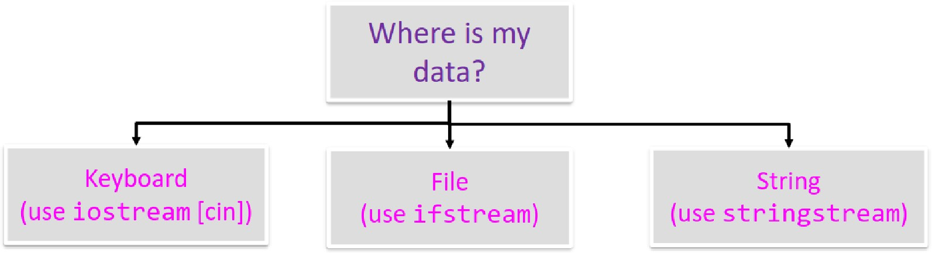
I/O Decision Tree

Slide 9
Outline
Stream Concept
How to interact with files using fstream
Reading in a File Writing to a File
String Streams

Slide 10
Outline
Stream Concept
How to interact with files using fstream
Reading in a File Writing to a File
String Streams

Slide 11
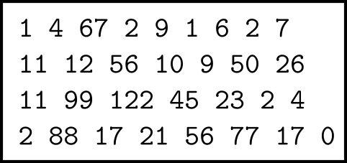
Reading in a File
Let say we want to read the data.txt file

Slide 12
Step 1: Open the file
Remember to include the fstream header to use the fstream type
#include<fstream>
Before we can use an input stream in a program, we must create stream object:
ifstream inFile;
To connect the ifstream inFile to the file ”data.txt”, we use the following statement:
inFile.open("data.txt");

Slide 13
Checking for Failure with File Commands
The either of following commands is used to check if the stream is valid
inFile.is_open()
inFile.fail()
int main()
{
ifstream inFile;
inFile.open("Lecture4"); if (inFile.fail())
{
cout << "Unable to open file!\n"; exit(0);
}
...

Slide 14
Step 2: Read the file - One word at a time
Read one word at a time using extraction operator >>
int num;
vector<int> vec; int total = 0;
while(inFile >> num) {
// do something with num vec.push_back(num); total += num;
}

Slide 15
Step 3: Close the file
To disconnect connect the ifstream ”inFile” to whatever file it is connected to, we write:
inFile.close();
inFile.open("other_data.txt"); // open another file

Slide 16
Outline
Stream Concept
How to interact with files using fstream
Reading in a File Writing to a File
String Streams

Slide 17
Step 1: Open the file
Before we can use an output stream in a program, we must create stream object:
ofstream outFile;
To connect the ofstream outFile to the file ”result.txt”, we use the following statement:
outFile.open("result.txt");

Slide 18
Step 2+3: Write the file, then close
int main(){
...
outFile << "List of numbers: "; for (int num : vec)
outFile << num << " ";
outFile << "\n";
outFile << "Sum = " << total << endl; outFile.close();

Slide 19
That Looks Familiar...
If file-writing syntax seems similar to printing to the console, that’s because it is!
- cin is an ifstream; cout is an ofstream

Slide 20
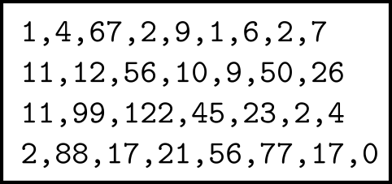
Here’s the problem
What if the input file looks like this ...

Slide 21
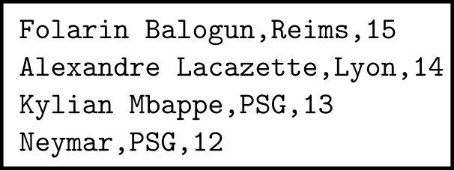
Here’s the problem
What if the input file looks like this ...
or this ...

Slide 22
getline() and stringstreams
A file has a certain format where you know related data is on a single line of text but aren’t sure how many data items will be on that line
Can’t use >>
We can use getline() to get the whole line as a string, then a stringstream with
>> to parse out the pieces (Tokenizing a string)

Slide 23
Outline
Stream Concept
How to interact with files using fstream
Reading in a File Writing to a File
String Streams

Slide 24
stringstream
Sometimes we want to be able to treat a string like a stream. Useful scenarios:
Converting between data types
Tokenizing a string
Include header file sstream to use stringstream type:
#include <sstream>

Slide 25
istringstream
An istringstream lets you tokenize a string.
Let’s extract data from the line "Balogun Reims 15"
string line = "Balogun Reims 15";
...
...
...
...
...
...

Slide 26
istringstream
An istringstream lets you tokenize a string.
Let’s extract data from the line "Balogun Reims 15"
string line = "Balogun Reims 15";
istringstream iss(line); string name;
string club;
int numGoal;
iss >> name >> club >> numGoal;
cout << name << "-" << club << "-" << numGoal << endl;

Slide 27
istringstream - using Delimeters
How about we change the line a bit:
"Balogun Reims 15" → "Balogun, Reims, 15"
string line = "Balogun, Reims, 15";
...
...
...
...
...
...
...
...

Slide 28
std::getline()
Used to read a line from an input stream
istream& getline(istream& is, string& str, char delim);
is: the stream getline reads from
str: where it stores output in
delim: Stops when read (’newline’ = default)
How it works:
Clears contents in str
Extracts chars from is and stores them in str until:
End of file reached
Next char in is is delim, extracts but does not store delim

Slide 29
istringstream - using Delimeters
How about we change the line a bit:
"Balogun Reims 15" → "Balogun, Reims, 15"
string line = "Balogun, Reims, 15"; istringstream iss(line);
string token;
getline(iss, token, ’,’);
cout << token << endl; // token = Balogun getline(iss, token, ’,’);
cout << token << endl; // token = Reims
getline(iss, token, ’,’);
cout << token << endl; // token = 15

Slide 30
ostringstream
An ostringstream lets you write output into a string buffer.
- Use the str method to extract the string that was built.
// produce a formatted string of output
int age = 42, iq = 95; ostringstream oss;
oss << "Zoidberg’s age is " << age << endl;
oss << " and his IQ is " << iq << "!" << endl; string result = oss.str();
// result = "Zoidberg’s age is 42\nand his IQ is 95!\n"

Slide 31
Choosing an I/O Strategy
Is my data delimited by particular characters?
Yes, stop on newlines: Use getline()
Yes, stop on other character: User getline() with optional 3rd character
No, Use >> to skip all whitespaces and convert to a different data type (int, double, etc.)
If ”yes” above, do I need to break data into smaller pieces (vs. just wanting one large string)
Yes, create a stringstream and extract using >>
No, just keep the string returned by getline()
Is the number of items you need to read known as a constant or a variable read in earlier?
Yes, Use a loop and extract (>>) values placing them in array or vector
No, Loop while extraction doesn’t fail placing them in vector
Remember: getline() always gives text/string. To convert to other types it is easiest to use >>

